Slide 1
THE COSTS OF PRODUCTION
Chapter 13
Notes:
1
1

Slide 2
The Costs of Production
The Law of Supply
 Firms are willing to produce and sell a greater quantity of a good when the price of the good is high.
 This results in a supply curve that slopes upward.
Notes:
2
2

Slide 3
The Firm’s Objective
The economic goal of the firm is to maximize profits.
Notes:
3
4

Slide 4
A Firm’s Total Revenue and Total Cost
Total Revenue
 The amount that the firm receives for the sale of its product.
Total Cost
 The amount that the firm pays to buy inputs.
Notes:
4
5

Slide 5
A Firm’s Profit
Profit is often referred to as producer surplus.
It is the amount a seller is paid minus costs.
Profit = Total revenue - Total cost
Notes:
5
5

Slide 6
Costs as Opportunity Costs
A firm’s costs of production include all the opportunity costs of making its output of goods and services.
Notes:
6
8

Slide 7
Explicit and Implicit Costs
A firm’s cost of production include explicit costs and implicit costs.
 Explicit costs involve a direct money outlay for factors of production.
 Implicit costs do not involve a direct money outlay.
Notes:
7
8

Slide 8
Economic Profit versus Accounting Profit
Economists include all opportunity costs when measuring costs.
Accountants measure the explicit costs but often ignore the implicit costs.
Notes:
8
9

Slide 9
Economic Profit versus Accounting Profit
When total revenue exceeds both explicit and implicit costs, the firm earns economic profit.
 Economic profit is smaller than accounting profit.
Notes:
9
9

Slide 10
Economic Profit versus Accounting Profit
How an Economist
Views a Firm
Economic
profit
Implicit
Revenue
costs
Total
opportunity
costs
Explicit
costs
Notes:
10
9

Slide 11
Economic Profit versus Accounting Profit
How an Economist
How an Accountant
Views a Firm
Views a Firm
Economic
profit
Accounting
profit
Implicit
Revenue
costs
Revenue
Total
opportunity
costs
Explicit
Explicit
costs
costs
Notes:
11
9

Slide 12
Production and Costs
A firm’s costs reflect its production process.
Notes:
18
9

Slide 13
The Production Function
The production function shows the relationship between quantity of inputs used to make a good and the quantity of output of that good.
Notes:
19
9

Slide 14
Marginal Product
The marginal product of any input into production is the increase in the quantity of output obtained from an additional unit of that input.
Notes:
20
9

Slide 15

Marginal Product
The marginal product of any input into production is the increase in the quantity of output obtained from an additional unit of that input.
Notes:
21
9

Slide 16
Diminishing Marginal Product
Diminishing marginal product is the property whereby the marginal product of an input declines as the quantity of the input increases.
Example: As more and more workers are hired at a firm, each additional worker contributes less and less to production because the firm has a limited amount of equipment.
Notes:
22

Slide 17
Diminishing Marginal Product
The slope of the production function measures the marginal product of an input, such as a worker.
When the marginal product declines, the production function becomes flatter.
Notes:
23

Slide 18
A Production Function
Quantity of
Output
(cookies
per hour)
150
Production function
140
130
120
110
100
90
80
70
60
50
40
30
20
10
0
1
2
3
4
5
Number of Workers Hired
Notes:
24

Slide 19
Production Function and Total Costs
The relationship between the quantity a firm can produce and its costs determines its pricing decisions.
The total-cost curve shows this relationship graphically.
Notes:
25

Slide 20
A Production Function and Total Cost
Number of
Output
Marginal
Cost of
Cost of
Total Cost
Workers
(Quantity)
Product of
Factory
Workers
of Inputs
Labor
0
0
$30
$0
$30
1
50
50
30
10
40
2
90
40
30
20
50
3
120
30
30
30
60
4
140
20
30
40
70
5
150
10
30
50
80
Notes:
26
9

Slide 21
Total-Cost Curve
Total
Cost
$80
Total-cost
curve
70
60
50
40
30
20
10
0
20
40
60
80
100
120
140
Quantity of Output
(cookies per hour)
Notes:
27

Slide 22
The Various Measures of Cost
Costs of production may be divided into fixed costs and variable costs.
Notes:
28
12

Slide 23
The Various Measures of Cost
Fixed costs are those costs that do not vary with the quantity of output produced.
Notes:
29
12

Slide 24
The Various Measures of Cost
Variable costs are those costs that do vary with the quantity of output produced.
Notes:
30
12

Slide 25
Family of Total Costs
Total Fixed Costs (TFC)
Total Variable Costs (TVC)
Total Costs (TC)
TC = TFC + TVC
Notes:
31
14

Slide 26
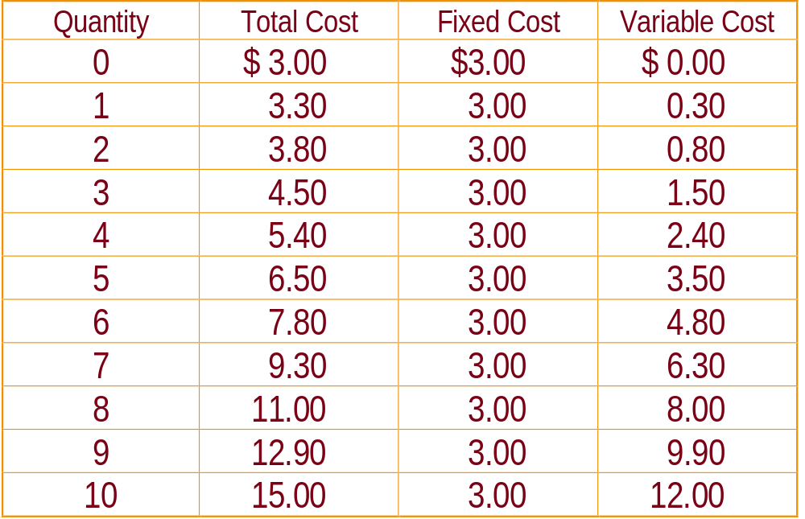
Family of Total Costs
Notes:
32
14

Slide 27
Average Costs
Average costs can be determined by dividing the firm’s costs by the quantity of output produced.
The average cost is the typical cost of each unit of product.
Notes:
33

Slide 28
Family of Average Costs
Average Fixed Costs (AFC)
Average Variable Costs (AVC)
Average Total Costs (ATC)
Notes:
34
15

Slide 29
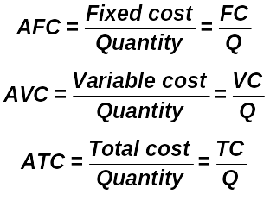
Family of Average Costs
Notes:
35
15

Slide 30
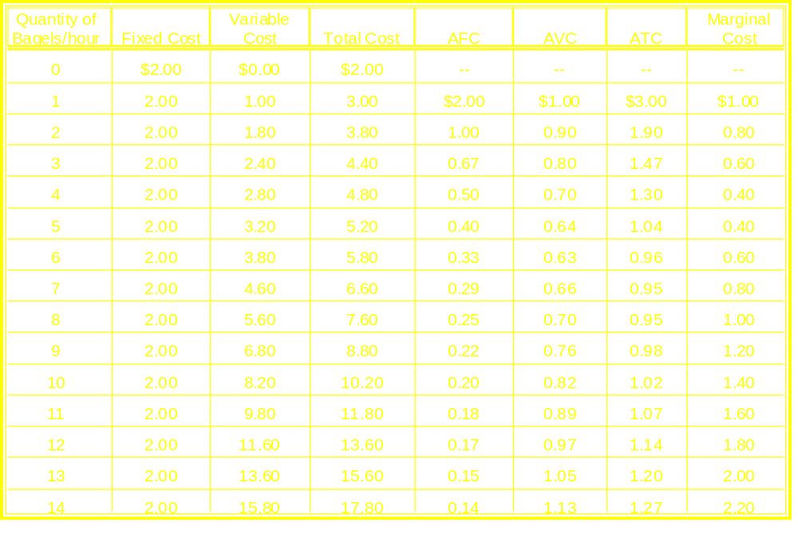
Table 13-3 Various Measures of Cost: Big Bob’s Bagel Bin

Slide 31
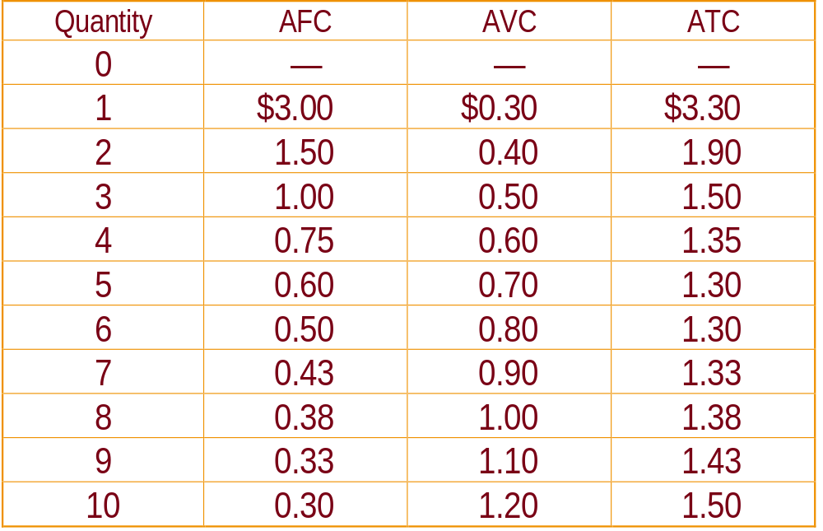
Family of Average Costs
Notes:
36
14

Slide 32
Marginal Cost
Marginal cost (MC) measures the increase in total cost that arises from an extra unit of production.
Marginal cost helps answer the following question:
 How much does it cost to produce an additional unit of output?
Notes:
37
16

Slide 33
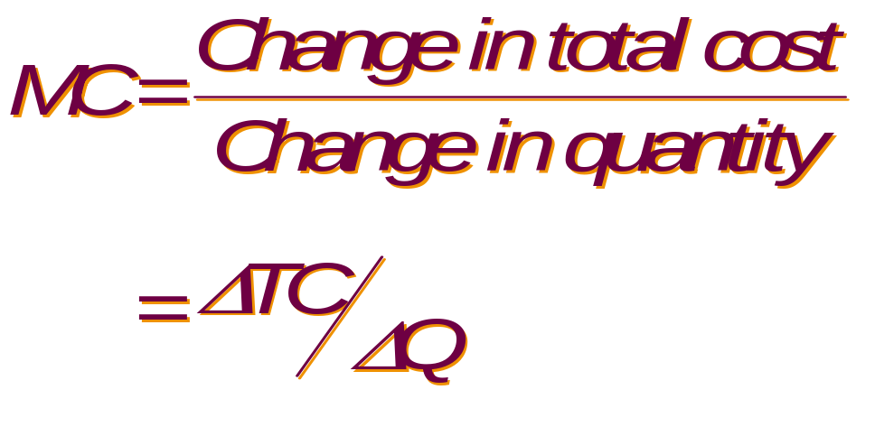
Marginal Cost
Notes:
38
16

Slide 34
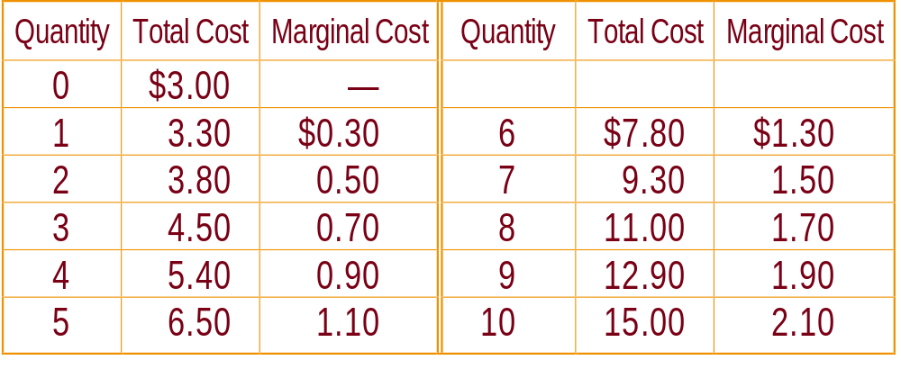
Marginal Cost
Notes:
39
16

Slide 35

Quick Quiz!
Ford’s total cost of producing 4 cars is $225,000 and its total cost of producing 5 cars is $250,000.
Notes:
40
18

Slide 36

Quick Quiz!
What is the average total cost and marginal cost of producing the fifth car?
Notes:
41
18

Slide 37
Cost Curves and Their Shapes
Marginal cost rises with the amount of output produced.
 At low levels of output, an increase in production will occur at a relatively small cost.
 Increasing output is more costly when the amount being produced is already high.
Notes:
42
19

Slide 38
Cost Curves and Their Shapes
Costs
$3.00
2.75
2.50
2.25
2.00
1.75
1.50
1.25
1.00
0.75
0.50
0.25
0
1
2
3
4
5
6
7
8
9
10
11
12
13
14
Quantity of Output
(bagels per hour)
Notes:
43
20

Slide 39
Cost Curves and Their Shapes
Costs
$3.00
2.75
2.50
2.25
MC
2.00
1.75
1.50
1.25
1.00
0.75
0.50
0.25
0
1
2
3
4
5
6
7
8
9
10
11
12
13
14
Quantity of Output
(bagels per hour)
Notes:
44
20

Slide 40
Cost Curves and Their Shapes
The average total-cost curve is U-shaped.
 At very low levels of output average total cost is high because fixed cost is spread over only a few units.
 Average total cost declines as output increases.
 Average total cost starts rising because average variable cost rises substantially.
Notes:
45
19

Slide 41
Cost Curves and Their Shapes
Costs
$3.00
2.75
2.50
2.25
2.00
1.75
1.50
1.25
1.00
0.75
0.50
0.25
0
1
2
3
4
5
6
7
8
9
10
11
12
13
14
Quantity of Output
(bagels per hour)
Notes:
46
21

Slide 42
Cost Curves and Their Shapes
Costs
$3.00
2.75
2.50
2.25
2.00
1.75
1.50
ATC
1.25
1.00
AVC
0.75
0.50
0.25
AFC
0
1
2
3
4
5
6
7
8
9
10
11
12
13
14
Quantity of Output
(bagels per hour)
Notes:
47
21

Slide 43
Relationship Between Marginal Cost and Average Total Cost
Whenever marginal cost is less than average total cost, average total cost is falling.
Whenever marginal cost is greater than average total cost, average total cost is rising.
Notes:
48

Slide 44
Relationship Between Marginal Cost and Average Total Cost
The marginal-cost curve crosses the average-total-cost curve at the efficient scale.
 Efficient scale is the quantity that minimizes average total cost.
Notes:
49
19

Slide 45
Relationship Between Marginal Cost and Average Total Cost
Costs
$3.00
2.75
2.50
2.25
2.00
1.75
1.50
1.25
1.00
0.75
0.50
0.25
0
1
2
3
4
5
6
7
8
9
10
11
12
13
14
Quantity of Output
(bagels per hour)
Notes:
50
29

Slide 46
Relationship Between Marginal Cost and Average Total Cost
Costs
$3.00
2.75
2.50
2.25
2.00
1.75
1.50
ATC
1.25
1.00
0.75
0.50
0.25
0
1
2
3
4
5
6
7
8
9
10
11
12
13
14
Quantity of Output
(bagels per hour)
Notes:
51
29

Slide 47
Relationship Between Marginal Cost and Average Total Cost
Costs
$3.00
2.75
2.50
2.25
MC
2.00
1.75
1.50
ATC
1.25
1.00
0.75
0.50
0.25
0
1
2
3
4
5
6
7
8
9
10
11
12
13
14
Quantity of Output
(bagels per hour)
Notes:
52
29

Slide 48
Costs in the Long Run
For many firms, the division of total costs between fixed and variable costs depends on the time horizon being considered.
 In the short run some costs are fixed.
 In the long run fixed costs become variable costs.
Notes:
53
24

Slide 49
Costs in the Long Run
Because many costs are fixed in the short run but variable in the long run, a firm’s long-run cost curves differ from its short-run cost curves.
Notes:
54
24

Slide 50
U-Shaped Long-Run Average Total Cost
Economies of scale occur when long-run average total cost falls as the quantity of output increases.
Notes:
55
24

Slide 51
U-Shaped Long-Run Average Total Cost
Diseconomies of scale occur when long-run average total cost rises as the quantity of output increases.
Notes:
56
24

Slide 52
U-Shaped Long-Run Average Total Cost
Constant returns to scale occur when long-run average total cost stays the same as the quantity of output increases.
Notes:
57
24

Slide 53
U-Shaped Long-Run Average Total Cost
Average
Total
Cost
0
Quantity of
Cars per Day
Notes:
58
24

Slide 54
U-Shaped Long-Run Average Total Cost
Average
Total
ATC in short
run with
small factory
Cost
0
Quantity of
Cars per Day
Notes:
59
24

Slide 55
U-Shaped Long-Run Average Total Cost
Average
Total
ATC in short
run with
small factory
ATC in short
run with
medium factory
Cost
0
Quantity of
Cars per Day
Notes:
60
24

Slide 56
U-Shaped Long-Run Average Total Cost
Average
Total
ATC in short
run with
small factory
ATC in short
run with
medium factory
ATC in short
run with
large factory
Cost
0
Quantity of
Cars per Day
Notes:
61
24

Slide 57
U-Shaped Long-Run Average Total Cost
Average
Total
Cost
0
Quantity of
Cars per Day
Notes:
62
24

Slide 58
U-Shaped Long-Run Average Total Cost
Average
Total
Cost
ATC in long run
0
Quantity of
Cars per Day
Notes:
63
24

Slide 59
U-Shaped Long-Run Average Total Cost
Average
Total
Cost
ATC in long run
Economies
of scale
0
Quantity of
Cars per Day
Notes:
64
24

Slide 60
U-Shaped Long-Run Average Total Cost
Average
Total
Cost
ATC in long run
Economies
of scale
Constant
returns to
scale
0
Quantity of
Cars per Day
Notes:
65
24

Slide 61
U-Shaped Long-Run Average Total Cost
Average
Total
Cost
ATC in long run
Economies
of scale
Constant
returns to
scale
Diseconomies
of scale
0
Quantity of
Cars per Day
Notes:
66
24

Slide 62

Quick Quiz!
When Boeing produces 9 jets per month, its long-run total cost is $9.0 million per month.
Notes:
67
18

Slide 63
Quick Quiz!
When Boeing produces 10 jets per month, its long-run total cost is $9.5 million per month.
Notes:
68
18

Slide 64
Quick Quiz!
Does Boeing exhibit economies or diseconomies of scale?
Notes:
69
18

Slide 65
Conclusion
The goal of firms is to maximize profit, which equals total revenue minus total cost.
Some costs are explicit. Other costs, such as opportunity costs, are implicit.
A firm has fixed and variable costs. Fixed costs don’t vary with quantities produced; variable costs do.

Slide 66
Conclusion
Average total cost is total cost divided by the quantity of output.
Marginal cost is the amount total cost rises if output is increased by one unit.
Marginal cost generally rises with the quantity of output; average total cost first falls as output increases and then eventually rises with further output.

Slide 67
Conclusion
A firm’s costs often depend on the time horizon being considered.
Many costs are fixed in the short run but variable in the long run.
When the level of production changes, average total cost may rise more in the short run than in the long run.

Slide 68
THE COSTS OF PRODUCTION
End of Chapter 13
Notes:
70
1

